Slide 1

Online CSE-NITK Website
and Management Software
Under the guidance of Mr. Sourav Kanti
Submitted By:
Prashant Bhilwar(202CS020)
Sandeep Mishra(202CS026)
Satyam Prakash(202CS027)
Joan Lusanji (202CS034)

Slide 2
Content
Waterfall Model (SDLC)
System Analysis
Technology Used
Flowchart Diagram
ER Diagram
Interfaces
Individual contribution
References

Slide 3
Waterfall Model
Requirements
Design
Development
Testing
Deployment
Maintenance

Slide 4
System Analysis
Identifying the need.
Conducting preliminary investigation.
Feasibility study

Slide 5
Technology Used
HTML & CSS : For frontend we had used HTML(Hyper Text Markup language , CSS(Cascading Style Sheets) and JavaScript . We had used atom and sublime editor for that purpose.
PHP & MySQL: For backend and database handling we had used PHP(Hypertext Preprocessor ) & MySQL.
Apache : For server Apache is used using Xampp.

Slide 6
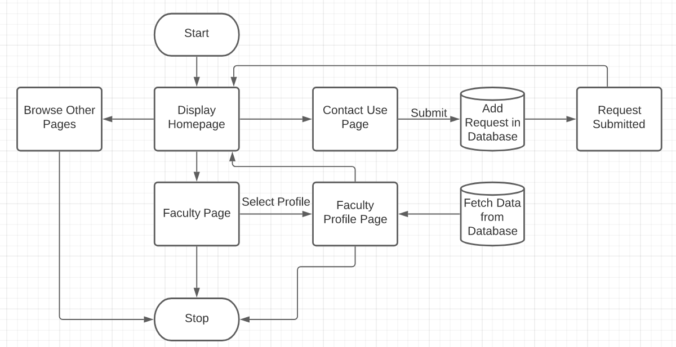
Flowchart Diagram

Slide 7
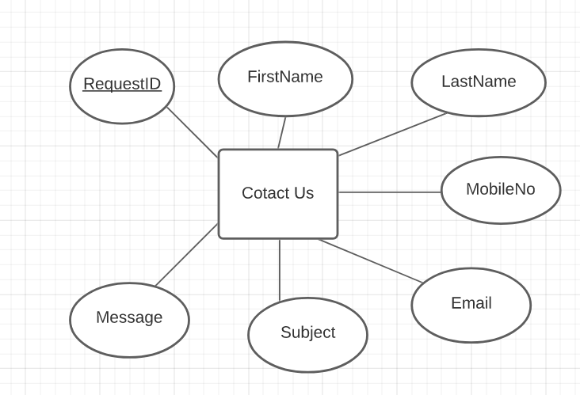
ER Diagram

Slide 8
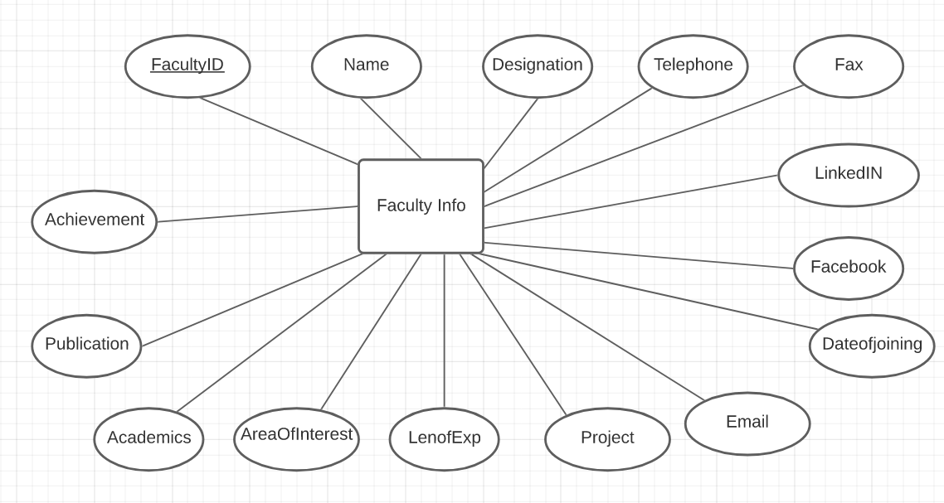
ER Diagram

Slide 9
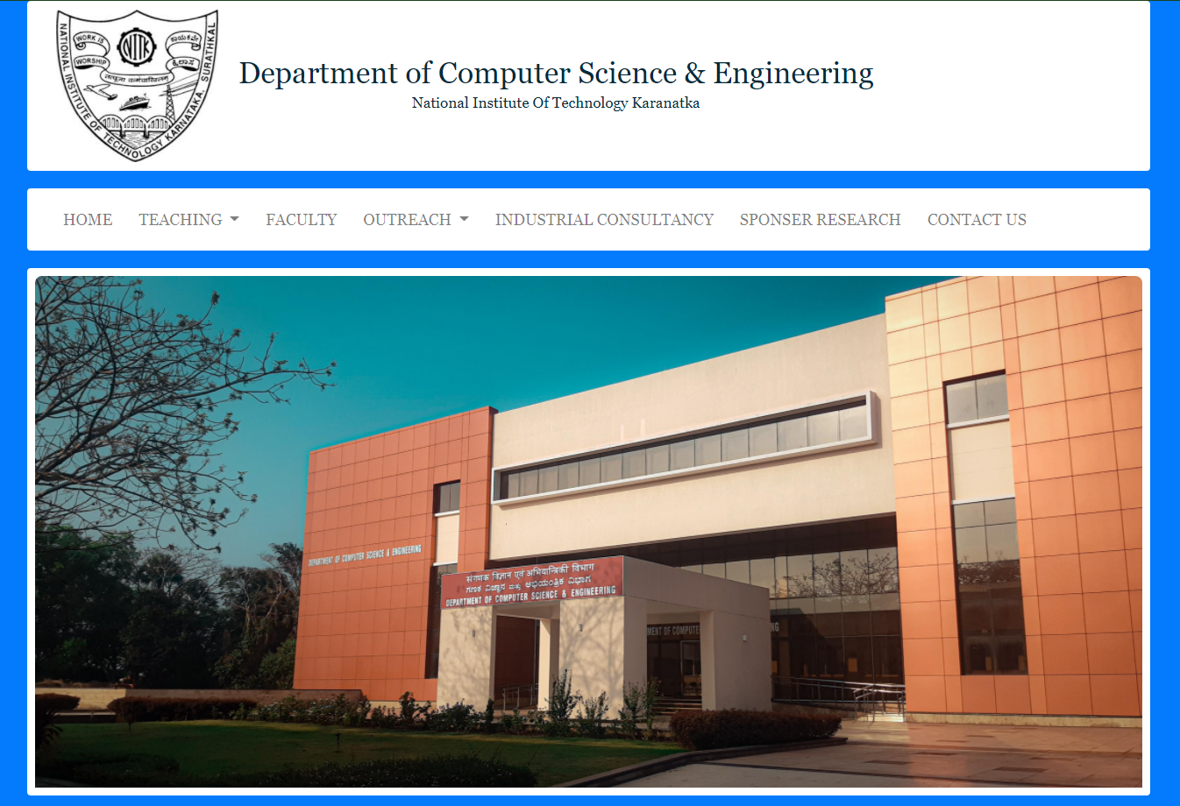
Interface

Slide 10
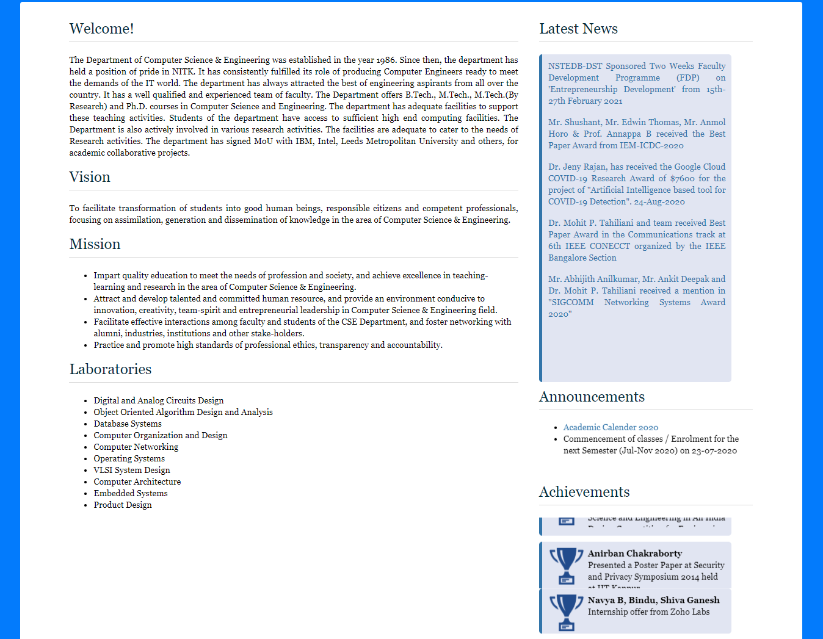

Slide 11
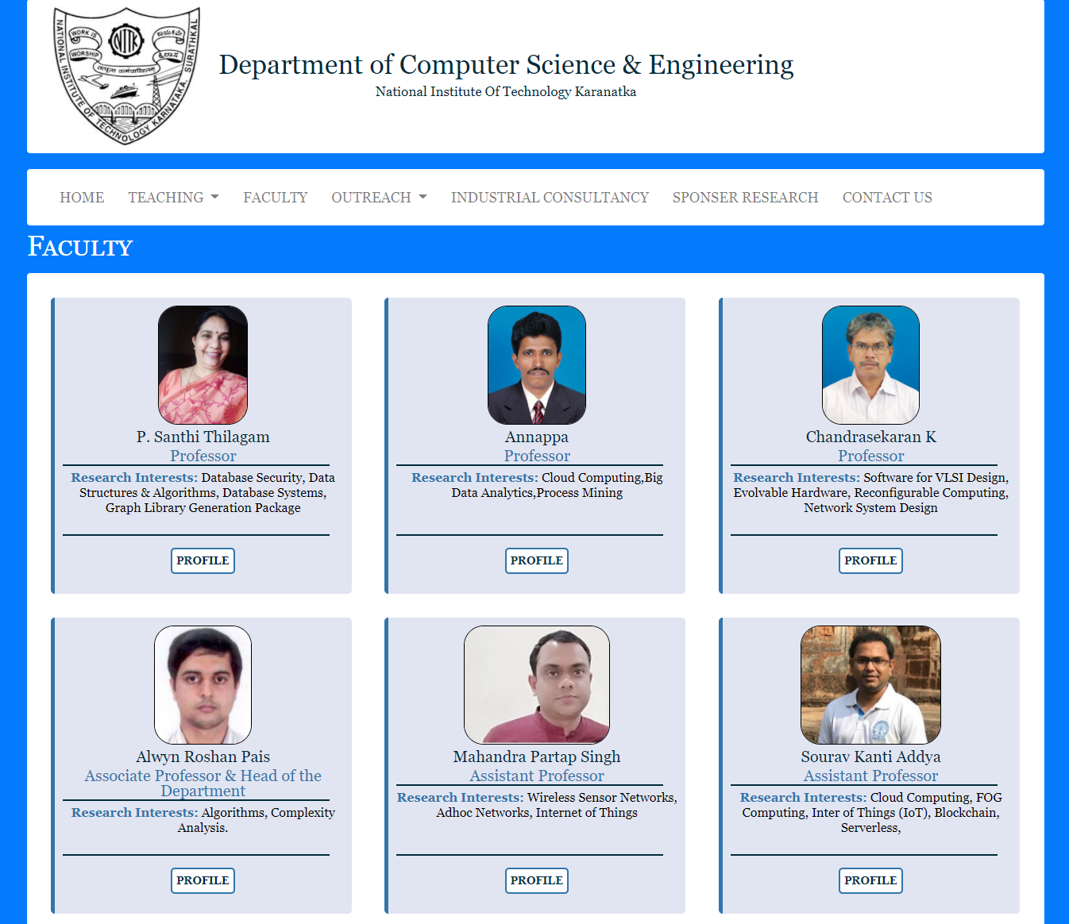

Slide 12
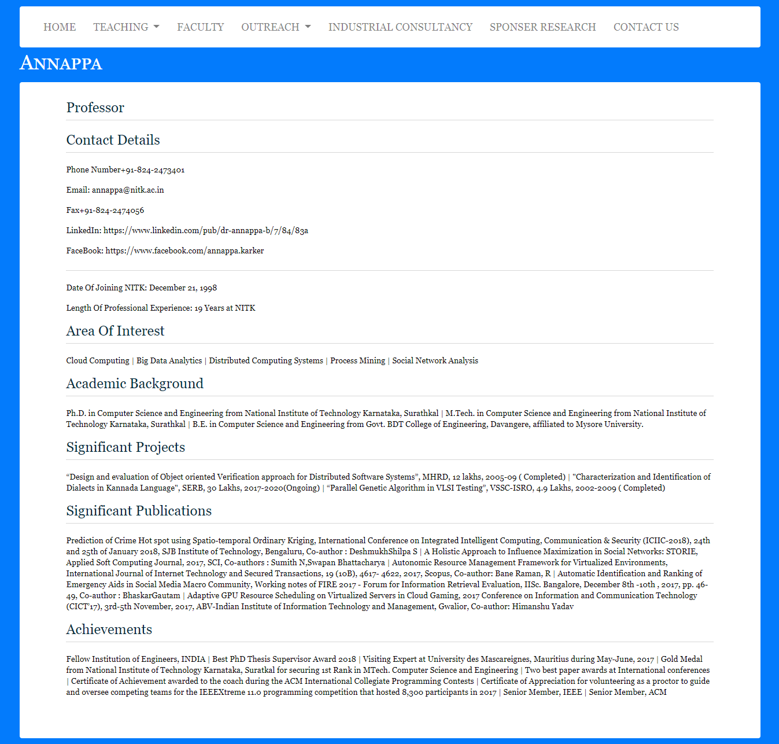

Slide 13
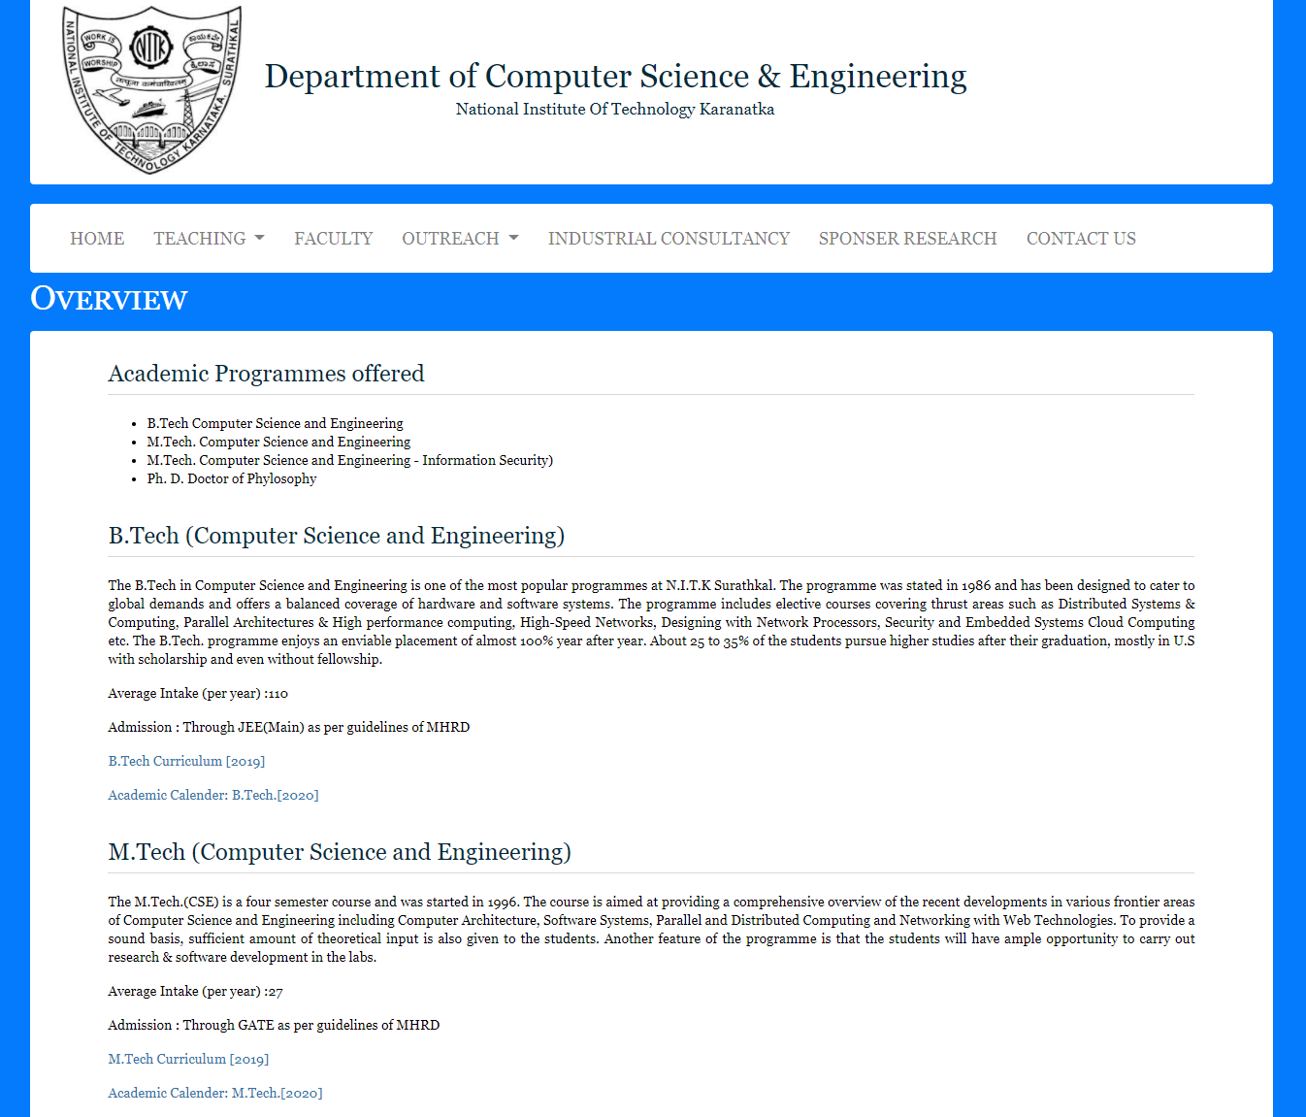

Slide 14
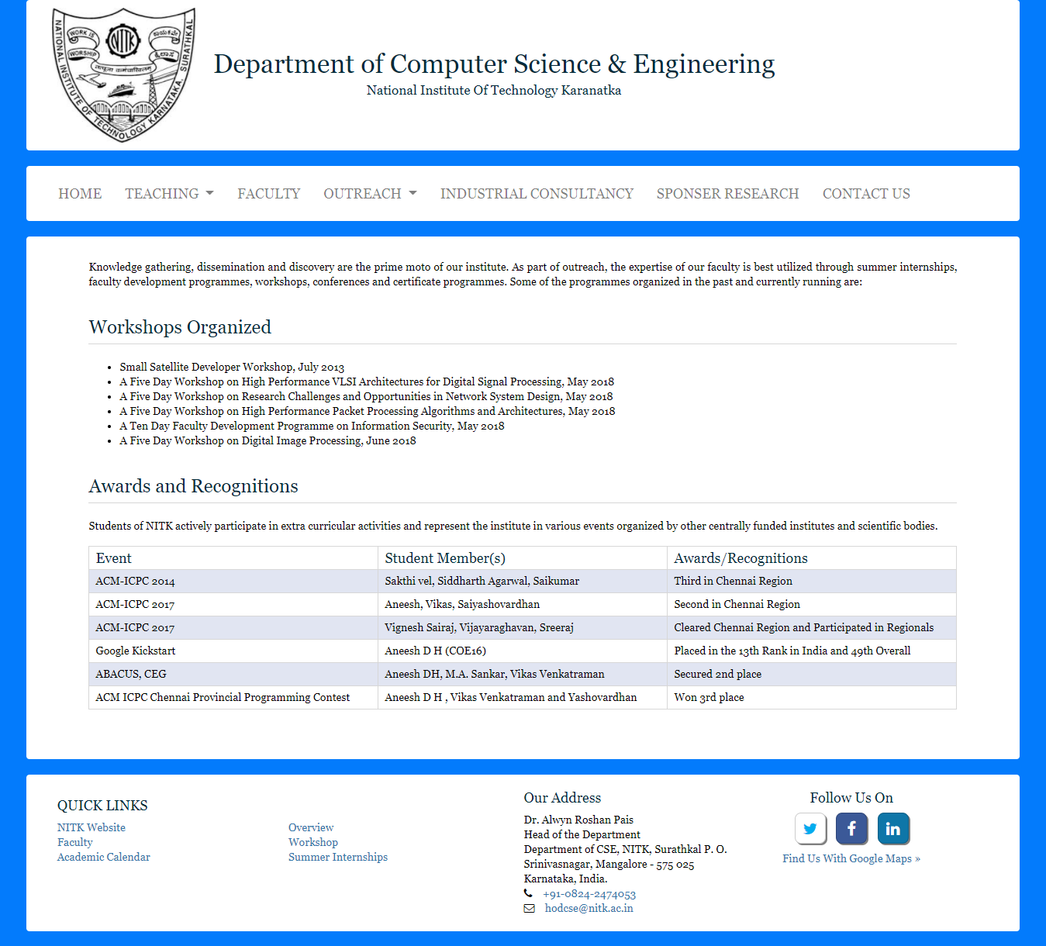

Slide 15
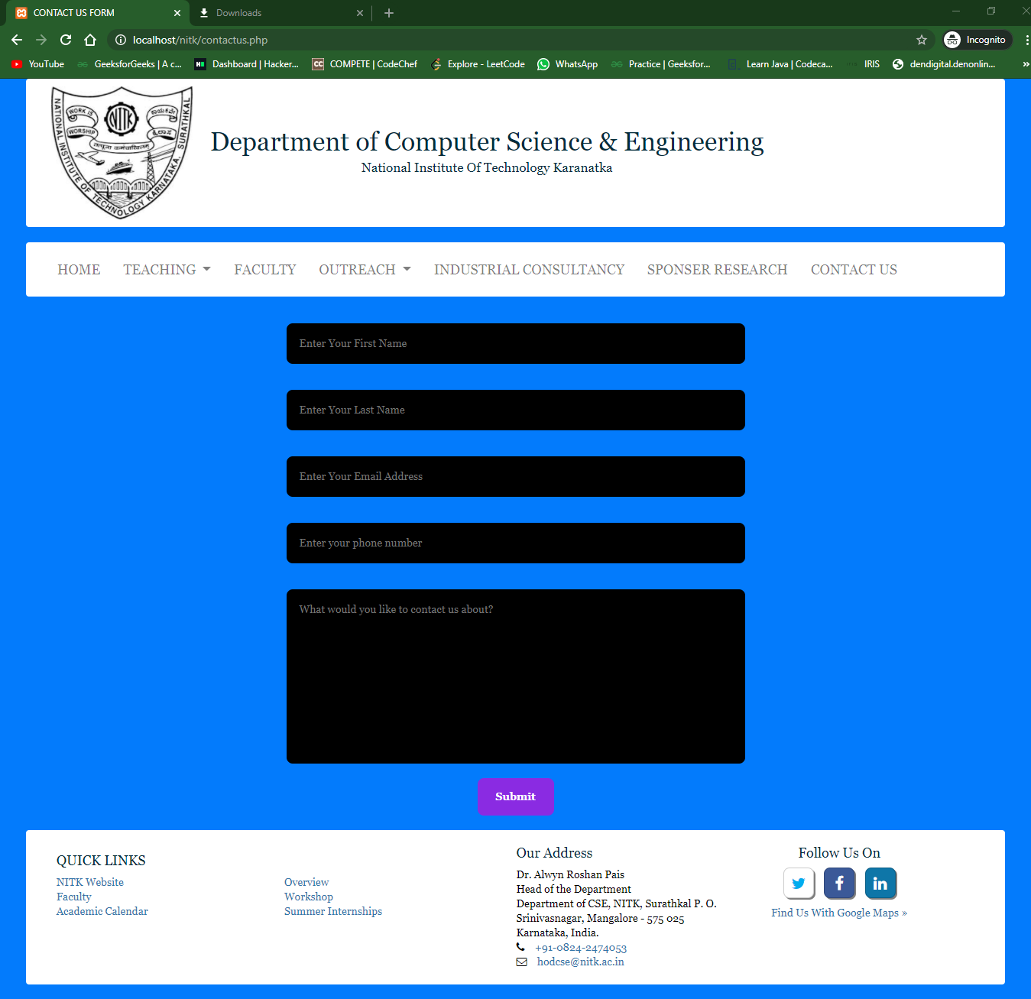

Slide 16
Individual Contribution
Prashant : Backend Connectivity for ContactUs Page, Flowchart Design, ER Diagram, Report.
Sandeep : Front end part is done by Sandeep Mishra by using HTML and CSS.
Satyam : Back end design and implementation.
Joan : Architecture design, did a significant part in front end and addition of style to the website.

Slide 17
References
https://www.nitk.ac.in/
https://www.w3schools.com/
https://www.tutorialspoint.com/index.htm
https://1stwebdesigner.com/best-web-designer/
https://www.geeksforgeeks.org/php/

